Slide 1
Algorithm Analysis: Efficiency and Complexity
"bit twiddling: 1. (pejorative) An exercise in tuning (see tune) in which incredible amounts of time and effort go to produce little noticeable improvement, often with the result that the code becomes incomprehensible."
- The Hackers Dictionary, version 4.4.7

Slide 2
Efficiency
How efficient is a program?
How much time does it take the program to run?
How much memory does it use?
How do these change as the amount of data changes?
What is the difference between the best case and worst case efficiency, if any?

Slide 3
Approach
Informal technique first
Some simplifications:
viewing algorithms as programs
counting executable statements in program or function
finding number of statements as a function of the amount of data
focusing on the dominant term in the function

Slide 4
Counting Statements
int x; // one statement
x = 5; // one statement
int y = x + 3 % 7 *x/n; // one statement
x++; // one statement
bool p = x < y && y % 2 == 0 || z >= y * x; // one
int list[100] = {0}; // 100
list[0] = x*x + y*y; // one

Slide 5
Question
What is output by the following code?
int total = 0;
for(int i = 0; i < 13; i++)
for(int j = 0; j < 11; j++)
total += 2;
printf("%d\n", total);
A. 24
B. 120
C. 143
D. 286
E. 338

Slide 6
Question
What is the output when function sample is called?
// pre: n >= 0, m >= 0
void sample(int n, int m) {
int total = 0;
for(int i = 0; i < n; i++)
for(int j = 0; j < m; j++)
total += 5;
printf("%d\n", total);
}
A. 5 D. n^{m}
B. n*m E. (n*m)⁵
C. n*m*5

Slide 7
Example
int total(int values[], int N) {
int result = 0;
for(int i = 0; i < N; i++)
result += values[i];
return result;
}
How many statements are executed by the function total as a function of N, the length of values?
In algorithm analysis, N is commonly used as a variable denoting the amount of data.

Slide 8
Counting Statements
int result = 0; 1
int i = 0; 1
i < N; N+1
i++ N
result += values[i]; N
return result; 1
T(N) = 3N + 4 is the number of executed statements as a function of N, the amount of data

Slide 9
A Simplification
When determining complexity of an algorithm, we want to simplify things – hide details to make the analysis easier
So: focus on the dominant term from the function, and ignore the coefficient

Slide 10
Big-O Notation
Big O: the most common method for discussing the run time of algorithms
The asymptotic execution time of the algorithm: the rate of growth in execution time as a function of the input size
Big-O is an upper bound on run time

Slide 11
Big-O
T(N) = O(F(N)) if there are positive constants c and N₀ such that |T(N)| < c|F(N)| when N > N₀
Since T typically represents number of operations, we'll often drop the absolute values
N is the size of the data set on which the algorithm is executed
T(N) is function describing the actual running time of the algorithm – it is the actual growth rate of the algorithm's run time
can be equated to number of executable statements in a program or function
F(N) is a function that characterizes an upper bound on T(N). It is a limit on the running time of the algorithm.
constants and lesser terms are ignored because it's a bounding function
c and N₀ are constants

Slide 12
Our Example: Showing O(N) correct
Recall formal definition of Big-O:
T(N) = O(F(N)) if there are positive constants c and N₀ such that T(N) < cF(N) when N > N₀
Recall function total, T(N) = 3N + 4. Show function total is O(N) (i.e., F(N) = N).
We need to choose constants c and N₀
how about c = 4, N₀ = 5?

Slide 13
vertical axis: time for algorithm to complete. (simplified to number of executable statements)
c * F(N), in this case, c = 4, c * F(N) = 4N
T(N), actual function of time. In this case 3N + 4
F(N), approximate function of time. In this case N
N_{o} = 5
horizontal axis: N, number of elements in data set

Slide 14
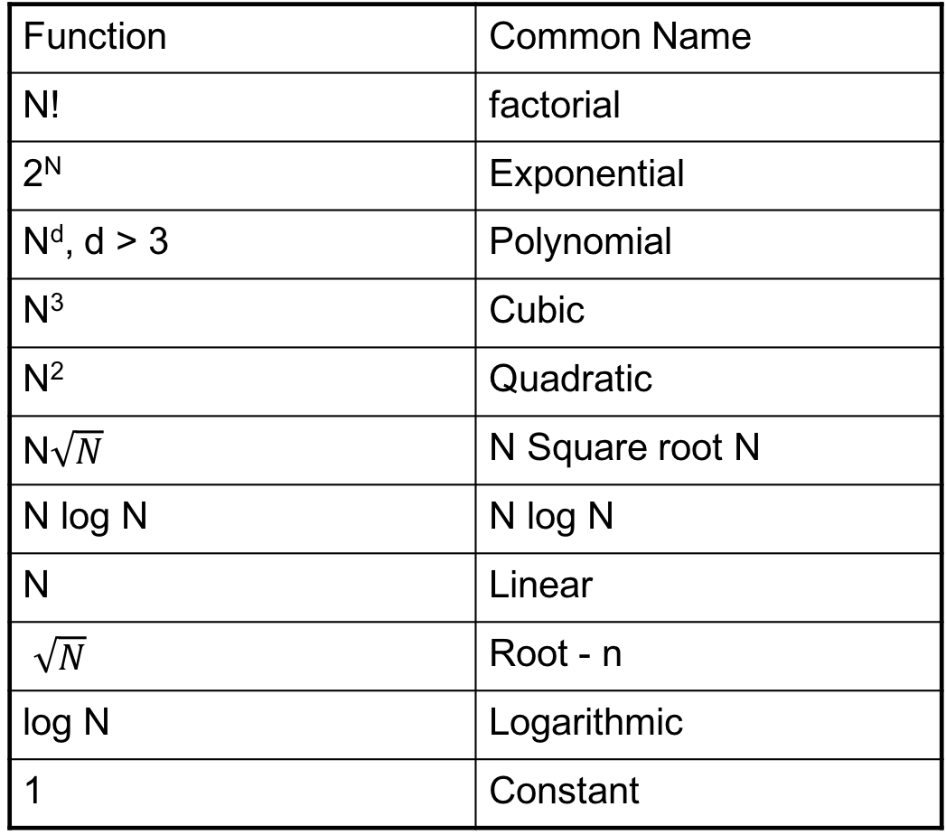
Big-O Functions
Function | Common Name
N! | factorial
2^{N} | Exponential
N^{d}, d > 3 | Polynomial
N³ | Cubic
N² | Quadratic
N$\sqrt{N}$ | N Square root N
N log N | N log N
N | Linear
$\sqrt{N}$ | Root - n
log N | Logarithmic
1 | Constant

Slide 15
Question
Which of the following is true?
A. Function total is O(N^{1/2})
B. Function total is O(N)
C. Function total is O(N²)
D. Two of A-C are correct
E. All three of A-C are correct

Slide 16
Function Calls and Big-O
double sum = 0;
for(int i = 0; i < n; i++)
sum += sqrt(i);
Long way: go to that function and count statements
Short way: substitute the simplified Big-O function for that function
If sqrt() is constant time, i.e., O(1), count sum += sqrt(i); as one statement

Slide 17
Function Calls and Big-O
int foo(int list[], int N) {
int total = 0;
for(int i = 0; i < N; i++)
total += countDups(list[i], list, N);
return total;
}
// Function countDups is O(N), where N is the size of the
// array passed in
What is Big O of foo?
A. O(1) B. O(N) C. O(NlogN) D. O(N²) E. O(N!)

Slide 18
Independent Loops
// For matrices
void scale(int numRows, int numCols, int cells[numRows][numCols], int factor) {
for(int r = 0; r < numRows; r++) {
for(int c = 0; c < numCols; c++) {
cells[r][c] *= factor;
}
Assume that N = numRows and N = numCols. What is the time complexity T(N)? What is the Big-O?
A. O(1) B. O(N) C. O(NlogN)
D. O(N²) E. O(N!)
Notes:
r = 0 (1). r < numRows (N+1) r++ (N). c = 0 (N). c< numCols( N(N+1)). c++ (N²). cells[r][c] *= factor. (N²)
T(N) = 1 + N+1 + N + N + N(N+!) + N² + N² = 2 + 4N + 3N² = O(N²)

Slide 19
Just Count Loops?
// assume mat is a 2d array of bools
// assume mat is square with N rows,
// and N columns
int numThings = 0;
for(int r = row - 1; r <= row + 1; r++)
for(int c = col - 1; c <= col + 1; c++)
if( mat[r][c] )
numThings++;
What is the order of the above code?
O(1) B. O(N) C. O(N²) D. O(N³) E. O(N^{1/2})

Slide 20
Not Just Counting Loops
// Second example from previous slide could be
// rewritten as follows:
int numThings = 0;
if( mat[r-1][c-1] ) numThings++;
if( mat[r-1][c] ) numThings++;
if( mat[r-1][c+1] ) numThings++;
if( mat[r][c-1] ) numThings++;
if( mat[r][c] ) numThings++;
if( mat[r][c+1] ) numThings++;
if( mat[r+1][c-1] ) numThings++;
if( mat[r+1][c] ) numThings++;
if( mat[r+1][c+1] ) numThings++;

Slide 21
Notes about Efficiency Analysis
Code is hard to analyze – we make these assumptions:
A single C statement takes a constant amount of time to execute
Function call's runtime: measured by total # of statements
The execution time of a sequence of statements equals the sum of their runtimes
if-else runtime: runtime of if test + runtime of chosen branch
in worst-case analysis, assume slowest branch is chosen
loop runtime: if loop repeats N times, N x (runtime of loop body)

Slide 22
Exercise
Function returns range of values in array argument – the distance between the smallest and largest elements
Example: h[] = {16, 29, 10, 4, 19, 6};
range(h, 6) returns 29-4 = 5
int range(int nums[], int N) {
int maxDiff = 0;
for(int i = 0; i < N; i++) {
for(int j = 0; j < N; j++) {
int diff = abs(nums[j] - nums[i]);
if(diff > maxDiff) maxDiff = diff;
}
}
return maxDiff;
}
Notes:
Is this an efficient algorithm? What is T(N)?

Slide 23
Exercise
What is T(N)?
int range(int nums[], int N) {
int maxDiff = 0; // 1
for(int i = 0; i < N; i++) { // 1 + (N+1) + N
for(int j = 0; j < N; j++) { // N(1 + (N+1) + N)
int diff = abs(nums[j] - nums[i]); // N²(1)
if(diff > maxDiff) maxDiff = diff; // N²(2) ← worst case
}
}
return maxDiff; // 1
}
T(N) = 3 + 2N + N(2N+2) + 3N²+1 = 5N² + 4N + 4
Now: carry out the Big-O analysis

Slide 24
Exercise
Show: T(N) = 5N² + 4N + 4 is O(N²)
Proof: Let c = 13 and N₀ = 1. Whenever N >= 1,
T(N) = 5N² + 4N + 4 <= 5N² + 4N² + 4N² = 13N².
Therefore, T(N) = O(N²).

Slide 25
range function
Can improve it by not looking at each pair of numbers twice:
int range(int nums[], int N) {
int maxDiff = 0;
for(int i = 0; i < N; i++) {
for(int j = i+1; j < N; j++) {
int diff = abs(nums[j] - nums[i]);
if(diff > maxDiff) maxDiff = diff;
}
}
return maxDiff;
}
How many times does the inner loop execute?
Notes:
Sum i = 0. N-1 (N – (i+1)) = (N-1) + (N-2) + (N-3) + ... + 1 = (N-1)N/2
j = i+1: N times
j < N: (N^2-N)/2 + 1
j++: (N^2-N)/2
inner loop body: 3(N^2-N)/2
Big-O: O(N^2)

Slide 26
range, version 3
int range(int nums[], int N) {
int max = nums[0]; // find max and min values
int min = max;
for(int i = 1; i < N; i++) {
if(nums[i] < min) min = nums[i];
if(nums[i] > max) max = nums[i];
}
return max – min;
}
Homework: What is T(N)? Do Big-O analysis (including proof.)

Slide 27
the logarithm
Review from Dr. Math
3² = 9
So log₃ 9 = 2
"The log to the base 3 of 9 is 2."
The way to think about log is:
"the log to the base x of y is the number you can raise x to to get y."
Say to yourself "The log is the exponent." (and say it over and over until you believe it.)
We work with base 2 logs often
log₂ 32 = ? log₂ 8 = ? log₂ 1024 = ? log₁₀ 1000 = ?

Slide 28
Math Background: Logarithms
Definition: X^{A} = B if and only if log_{X}B = A
Intuition: log_{X}B is the power X must be raised to, to get B
In EE312: a log with no base means that the base is 2
Identities:
log(AB) = logA + logB
log(A/B) = logA – logB
log(A^{B}) = B logA
log_{A}B = log_{C}B/log_{C}A
Example: log₄32 = (log₂32)/(log₂4) = 5/2
Practically speaking: all log_{c} is a constant multiple of log₂, so we can always think of logs as equivalent to log₂ in Big-O analysis.

Slide 29
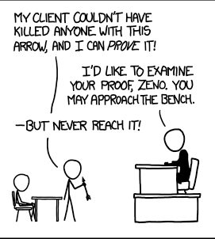
When Do Logarithms Occur
Algorithms tend to have a logarithmic term when they use a divide and conquer technique
the data set keeps getting divided by 2
int foo(int n) { // pre: n > 0 int total = 0; while( n > 0 ) { n = n / 2; total++; } return total; }
What is the order of the above code?
O(1) B. O(logN) C. O(N)
D. O(Nlog N) E. O(N²)

Slide 30
Example
int sum = 0;
for(int i = 1; i <= N; i *=c) {
sum++;
}
How many iterations of the loop?
Multiply by c each iteration
1, c, c², c³, ..., c^{k} = N
Number of iterations: k
c^{k} = N → log_{c}c^{k} = log_{c}N → k = log_{c}N
Runtime is O(logN)

Slide 31
A Useful Proportion
Since F(N) characterizes the running time of an algorithm the following proportion should hold true:
F(N₀) / F(N₁) ~= time₀ / time₁
An algorithm that is O(N²) takes 3 seconds to run given 10,000 pieces of data.
How long do you expect it to take when there are 30,000 pieces of data?
Notes:
10,000^2. ~ 3 sec
------------ -------
30,000^2 x sec
1/9. ~ 3/x
x = 27 sec

Slide 32
Proportion Examples
A function is O(N). It takes 2 seconds for the function to run when N=1,000,000. What is the expected time in seconds for the function to run when N=5,000,000?
A function is O(NlogN). It takes 1 second for the function to run when N=1,000. What is the expected time in seconds for the function to run when N=1,000,000?
Recall: log(x^{y}) = ylog(x)

Slide 33
Big-O Considerations
Often useful to discuss different cases for an algorithm
Best case: what is the best we can hope for?
Ex: Searching for an integer k in a list of N integers – k equals 1st list element we compare it to
Least interesting case
Average case (aka expected running time): what usually happens?
Worst case: what is the worst we can expect?
Ex: Must compare search key to every list element before finding it

Slide 34
Best, Average, Worst Case
To Determine the best, average, and worst case Big O we must make assumptions about the data set
Best case -> what are the properties of the data set that will lead to the fewest number of executable statements (steps in the algorithm)
Worst case -> what are the properties of the data set that will lead to the largest number of executable statements
Average case -> Usually this means assuming the data is randomly distributed
or if I ran the algorithm a large number of times with different sets of data what would the average amount of work be for those runs?

Slide 35
Example
double minimum(int N, double values[]) {
double minVal = values[0];
for(int i = 1; i < N; i++) {
if(values[i] < minVal)
minVal = values[i];
}
return minVal;
}
T(N)? F(N)? Big-O? Best case? Worst case? Average case?

Slide 36
Example of Dominance
Look at an extreme example. Assume the actual number as a function of the amount of data is:
N²/10000 + 2Nlog₁₀ N+ 100000
Is it plausible to say the N² term dominates even though it is divided by 10000 and that the algorithm is O(N²)?
What if we separate the equation into (N²/10000) and (2N log₁₀ N + 100000) and graph the results.

Slide 37
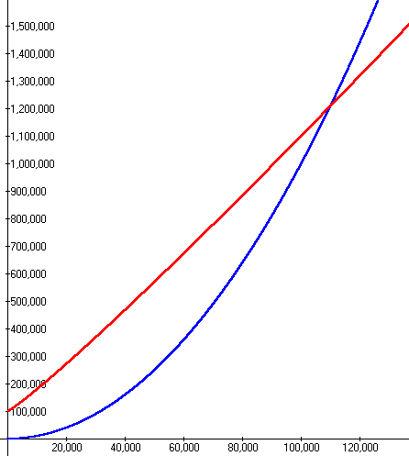
Summing Execution Times
red line is 2Nlog10 N + 100000
For large values of N the N² term dominates so the algorithm is O(N²)
blue line is N²/10000

Slide 38
Comparing Complexity Classes
Assume we have a problem
Algorithm A solves the problem correctly and is O(N²)
Algorithm B solves the same problem correctly and is O(Nlog₂N)
Which algorithm is faster?
One of the assumptions of Big O is that the data set is large.
The complexity classes should be accurate tools if this is true

Slide 39
Running Times
Assume N = 100,000 and processor speed is 1,000,000,000 operations per second
Function | Running Time
2^{N} | 3.2 x 10^{30,086} years
N⁴ | 3171 years
N³ | 11.6 days
N² | 10 seconds
N N | 0.032 seconds
N log N | 0.0017 seconds
N | 0.0001 seconds
N | 3.2 x 10⁻⁷ seconds
log N | 1.2 x 10⁻⁸ seconds

Slide 40
Formal Definition of Big-O (repeated)
T(N) is O( F(N) ) if there are positive constants c and N₀ such that T(N) < cF(N) when N > N₀
N is the size of the data set the algorithm works on
T(N) is a function that characterizes the actual running time of the algorithm
F(N) is a function that characterizes an upper bounds on T(N). It is a limit on the running time of the algorithm
c and N₀ are constants

Slide 41
Big-O: Formal Definition
There is a point N₀ such that for all values of N that are past this point, T(N) is bounded by some multiple of F(N)
Thus if T(N) of the algorithm is O(N²) then, ignoring constants, at some point we can bound the running time by a quadratic function.
given a linear algorithm it is technically correct to say the running time is O(N²). O(N) is a more precise answer as to the Big O of the linear algorithm
thus the caveat “pick the most restrictive function” in Big O type questions.

Slide 42
Big-O: What does it mean
T(N) is the actual growth rate of the algorithm
can be equated to number of executable statements in a program or chunk of code
F(N) is function that bounds the growth rate
Lingo: "T(N) grows no faster than F(N)"
T(N) often not equal to F(N)
constant multipliers and lesser terms are ignored since it's a bounding function

Slide 43
Other Algorithmic Analysis Tools
Big Omega T(N) is Ω(F(N)) if there are positive constants c and N₀ such that T(N) > cF(N)) when N > N₀
Big-O is similar to less than or equal, an upper bound
Big-Omega is similar to greater than or equal, a lower bound
Big Theta T(N) is θ(F(N)) if and only if T(N) is O(F(N)) and T(N) is Ω(F(N)).
Big Theta is similar to equals

